Slide 1
Employee Attrition Prediction
Created by : Sangram Sinha

Slide 2
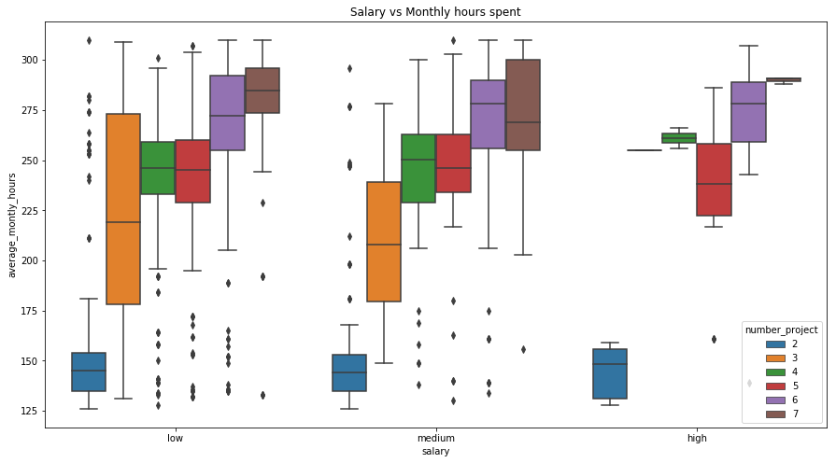
Employees are leaving because of higher number of projects and monthly hours spent

Slide 3
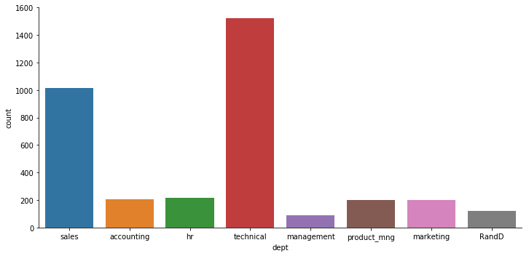
Sales and Technical employees mostly are leaving
Department wise distribution

Slide 4
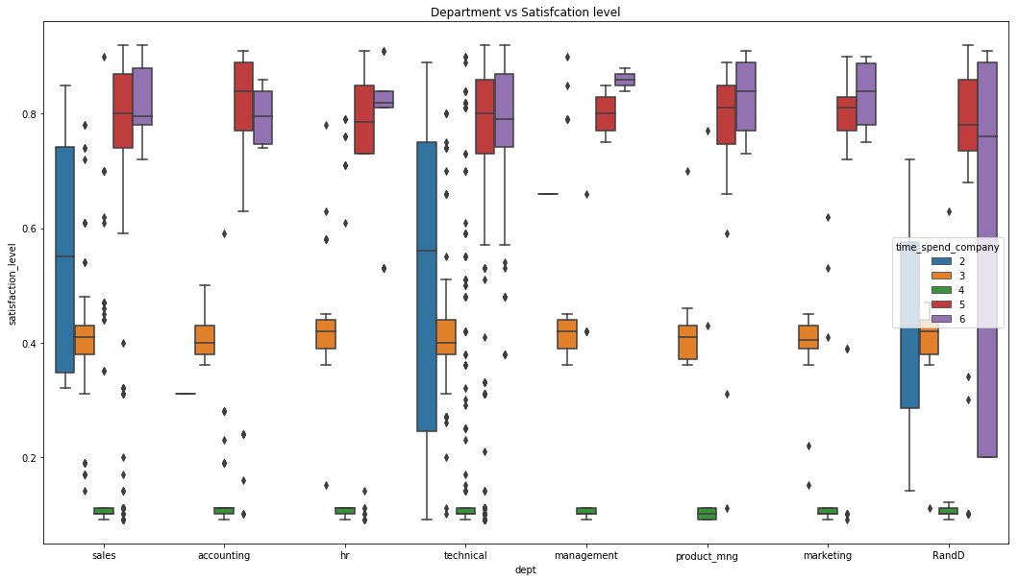
Time spent in the company from 2-4 years are not satisfied, Specially the employees with 4 years of time spend, they are having least satisfaction than others from every departments.

Slide 5
Factors driving employees to leave:
Below are some important features with % contribution towards attrition.
Satisfaction level : 34.77%
Time spend in the company : 28.24%
Average monthly hours : 12.05%
Latest Evaluation : 11.46%
Number of projects : 10.77
These are the driving factors which leads an employee to leave the company.

Slide 6
Thank You

